Slide 1

Lab -1(1) Introduction of Version Control using Git Lab
Software Engineering (SE)
# 2101CS503
Prof. Devangi L. Kotak
Computer Science & Engineering Department
devangi.kotak@darshan.ac.in

Slide 2
Version Control System
Version Control System (VCS) is a software that helps software developers to work together and maintain a complete history of their work.
We can roll back to any version we want without causing any trouble.
In VCS, a repository is an area that keeps all your project files, images, etc.
Top 10 VCS in 2023 are:
GitHub
Gitlab
Beanstalk
Helixcore
Apache subversion
AWS CodeCommit
Microsoft Team Foundation Server
Mercurial
Concurrent Versions System (CVS)
Bitbucket

Slide 3
GIT Introduction
Git is one of the version control system used to helps keep track of code changes.
It is free and open source software distributed under the terms of GNU General Public License version 2.
It is designed for coordinating work among programmers, but it can be used to track changes in any set of files.
It is distributed version control system for tracking changes in source code during software development.

Slide 4
Git Repository
Git repository contains the collection of the files as well as the history of changes made to those files.
There are two types of repository:
Local repository
Only admin of the machine can work with this repository
Central/Remote repository
Meant for team to share and exchange data
There are two ways to obtain a repository:
Create a local repository and make it as Git repository.
Clone a remote repository (already exists on a server).

Slide 5
Workflow of Git
Git has some special workflow to store files in repository.
d
Step 1 − Modify a file from the working directory.
The working directory is the place where files are stored in local machine.
Step 2 − Add these files to the staging area using add command.
Before commit operation, Git looks for the files present in the staging area.
Only those files present in the staging area are considered for commit and not all the modified files.
Step 3 − Perform commit operation that moves the files from the staging area and saved in local repository.
Working directory
Git add operation
Staging area
Git commit operation
Git repository

Slide 6


Git vs Gitlab
Version control system
Repository hosting service with CICD

Slide 7
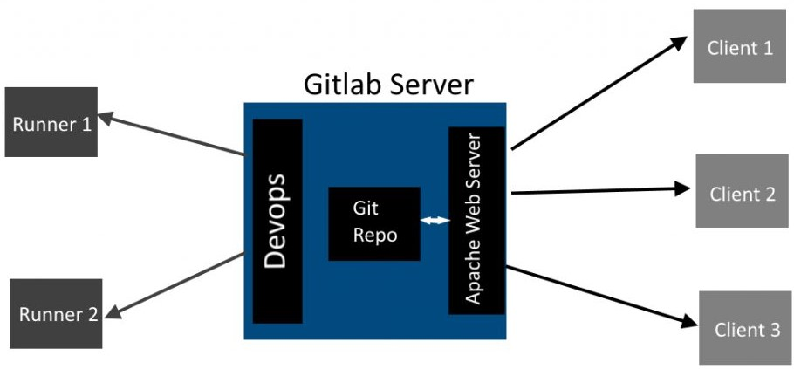
Git repository hosting platform
Gitlab is Git repository hosting plate form.
It is also called as open source software development tool which provides single app for every stage of development life cycle.
It facilitates the sharing of codebases among teams
It also offers CI/CD features to automate how build, test and deploy your projects.
CI/CD means Continuous Integration and Continuous Deployment.
In CI, frequent software updates are integrated from multiple developers and series of automated steps are triggered like compiling the code, running unit tests, performing code quality checks, and generating reports.
CD is the process of automatically deploying code changes to production or other environments after they pass the CI phase.

Slide 8
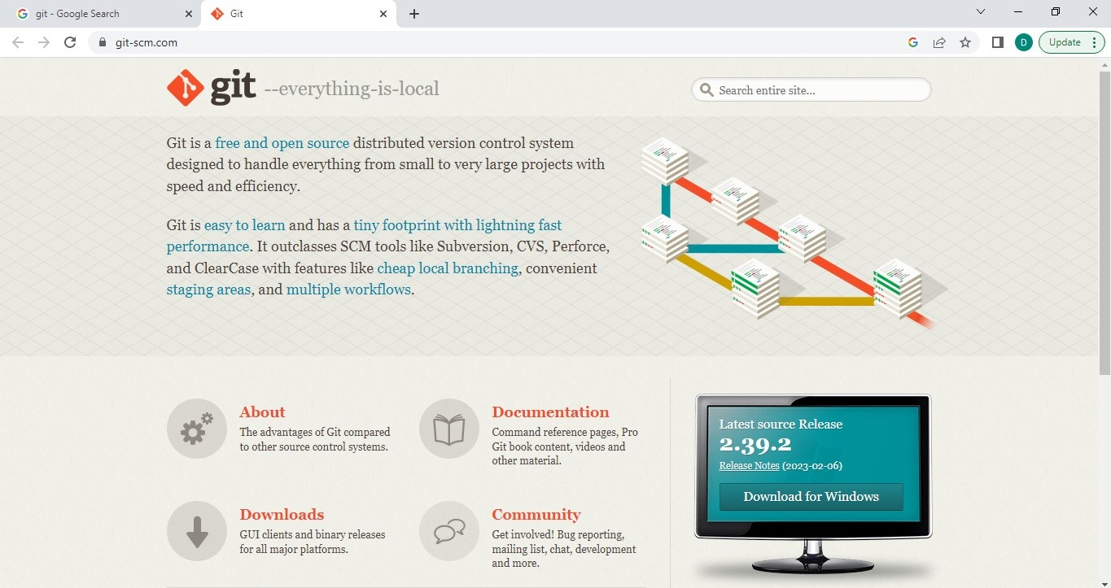
Installation of Git
From google, search ‘git’
Click on first link https://git-scm.com
Click on download from first page
Download git
Install git
Open Git bash/terminal

Slide 9
Working with Gitlab
Following steps shows sending your local repository into Gitlab remote server.
Step 1: Open www.gitlab.com
Step 2: Create account/signup -> use your git username and email
Step 3: Login into gitlab (use same username and email id which you have used while configuring git)
Step 4: Create new project in gitlab
Step 5: Goto git-bash/command-prompt of your computer
Step 6: Change directory to local project directory
Step 7: Add project in local repository
Step 8: Push project in gitlab using push command
Step 9: Authentic your account in gitlab
Then you can see your local repository in gitlab.

Slide 10
Initializing a Repository
To initialize a new repository, run the below command:
Syntax: $ git init
Output:
The above command will create a new subdirectory named .git that holds all necessary repository files.
An empty repository .git is added to my existing project.
STUDENT@DESKTOP-75WNUTC MINGW64 /c/My Project
$ git init
Initialized empty Git repository in C:/My Project/.git/
STUDENT@DESKTOP-75WNUTC MINGW64 /c/My Project (master)
$

Slide 11
Git Commands
Before working with Git bash, we have to configure user name and email id using config command.
Then Create one folder:
To change folder to that created folder:
STUDENT@DESKTOP-75WNUTC MINGW64 ~
$ git config –-global user.name “username”
STUDENT@DESKTOP-75WNUTC MINGW64 ~
$ git config –-global user.email “full email id”
STUDENT@DESKTOP-75WNUTC MINGW64 ~
$ mkdir myproject
STUDENT@DESKTOP-75WNUTC MINGW64 ~
$ cd myproject

Slide 12
Git Commands
To Initialize git:
To Add single files to staging area (this is a file/page of your project which you have saved into your folder in your computer):
To Add more files to staging area:
To Commit files to local repository:
$ git init
$ git add filename
$ git add –all
OR
$ git add .
$ git commit -m “any commit message”

Slide 13
Git Commands
To check status of files:
To check log history of committed changes:
To push that branch in gitlab
Use clone command to copy branch from remote repository
$ git status
$ git log
$ git push –u “URL of Gitlab repository” newbranch
$ git clone URL

Slide 14
Upload file in Gitlab
To upload file directly from gitlab UI
1. On the left sidebar, at the top, select Search GitLab () to find your project.
2. From the project dashboard or repository, next to the branch name, select the plus icon (+).
3. From the dropdown list, select Upload file.
4. Complete the fields. To create a merge request with the uploaded file, ensure the Start a new merge request with these changes toggle is turned on.
5. Select Upload file.

Slide 15
Software Engineering (SE)
# 2101CS503
Thank You
Prof. Devangi L. Kotak
Computer Science & Engineering Department
Darshan University, Rajkot
devangi.kotak@darshan.ac.in

